Slide 1
drugs.sdf

Slide 2
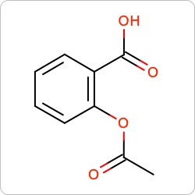
acetsali
SMILES (OpenEye): | CC(=O)Oc1ccccc1C(=O)O
NrHvyAtom: | 13
NrHetAtom: | 4
MolWt: | 180.16
MF: | C9H8O4
PSA: | 63.60
IUPAC name (OpenEye): | 2-acetoxybenzoic acid

Slide 3
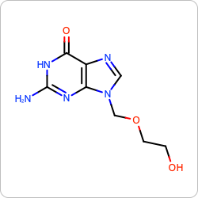
acyclovi
SMILES (OpenEye): | c1nc2c(=O)[nH]c(nc2n1COCCO)N
NrHvyAtom: | 16
NrHetAtom: | 8
MolWt: | 225.20
MF: | C8H11N5O3
PSA: | 119.05
IUPAC name (OpenEye): | 2-amino-9-(2-hydroxyethoxymethyl)-1H-purin-6-one

Slide 4
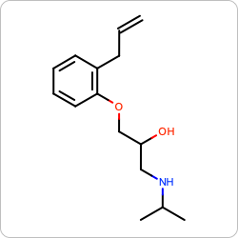
alprenol
SMILES (OpenEye): | CC(C)NCC(COc1ccccc1CC=C)O
NrHvyAtom: | 18
NrHetAtom: | 3
MolWt: | 249.35
MF: | C15H23NO2
PSA: | 41.49
IUPAC name (OpenEye): | 1-(2-allylphenoxy)-3-(isopropylamino)propan-2-ol

Slide 5
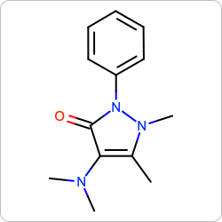
aminopy
SMILES (OpenEye): | Cc1c(c(=O)n(n1C)c2ccccc2)N(C)C
NrHvyAtom: | 17
NrHetAtom: | 4
MolWt: | 231.29
MF: | C13H17N3O
PSA: | 30.17
IUPAC name (OpenEye): | 4-(dimethylamino)-1,5-dimethyl-2-phenyl-pyrazol-3-one

Slide 6
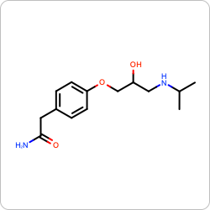
atenolol
SMILES (OpenEye): | CC(C)NCC(COc1ccc(cc1)CC(=O)N)O
NrHvyAtom: | 19
NrHetAtom: | 5
MolWt: | 266.34
MF: | C14H22N2O3
PSA: | 84.58
IUPAC name (OpenEye): | 2-[4-[2-hydroxy-3-(isopropylamino)propoxy]phenyl]acetamide

Slide 7
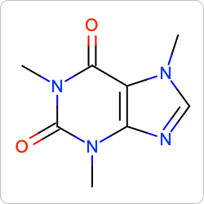
caffeine
SMILES (OpenEye): | Cn1cnc2c1c(=O)n(c(=O)n2C)C
NrHvyAtom: | 14
NrHetAtom: | 6
MolWt: | 194.19
MF: | C8H10N4O2
PSA: | 61.82
IUPAC name (OpenEye): | 1,3,7-trimethylpurine-2,6-dione

